Slide 1
SUSTech Pokemon
Proposal Presentation - E09

Slide 2
Group Members
Front-End
Rear-End
11911338 钟悦芸
Pokemons Modeling
UI
11910213 薛丁元
Structure Design
Coding Methods
11912627 孟宇阳
Scene Modeling
Animation
11910338 刘思岑
Game Design
Coding Methods

Slide 3
Feature description -
Front End

Slide 4






Pokemon Models
We have 15 3D models for 6 basic Pokemons and their evolutional forms
Before
Evolution
Pikachu
Charmander
Bulbasaur
After
Evolution
Raichu
Charmeleon
Ivysaur

Slide 5






Pokemon Models
We have 15 3D models for 6 basic Pokemons and their evolutional forms
Before
Evolution
Pikachu
Charmander
Bulbasaur
After
Evolution
Raichu
Charmeleon
Ivysaur

Slide 6
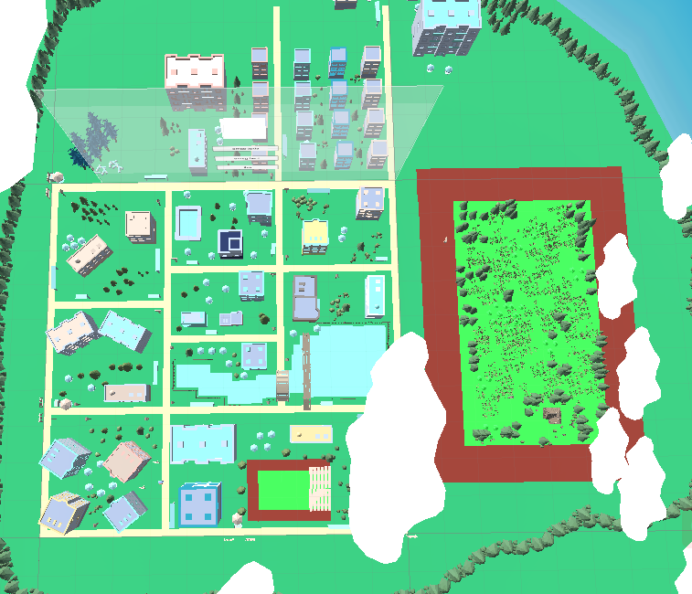
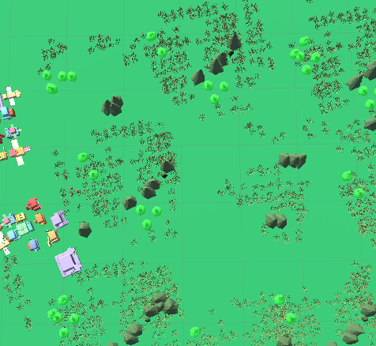
Scene Models
We have a fine and cartoon 3D modeling of our school, as the main scene of our game
Scene for Pokemon battle

Slide 7
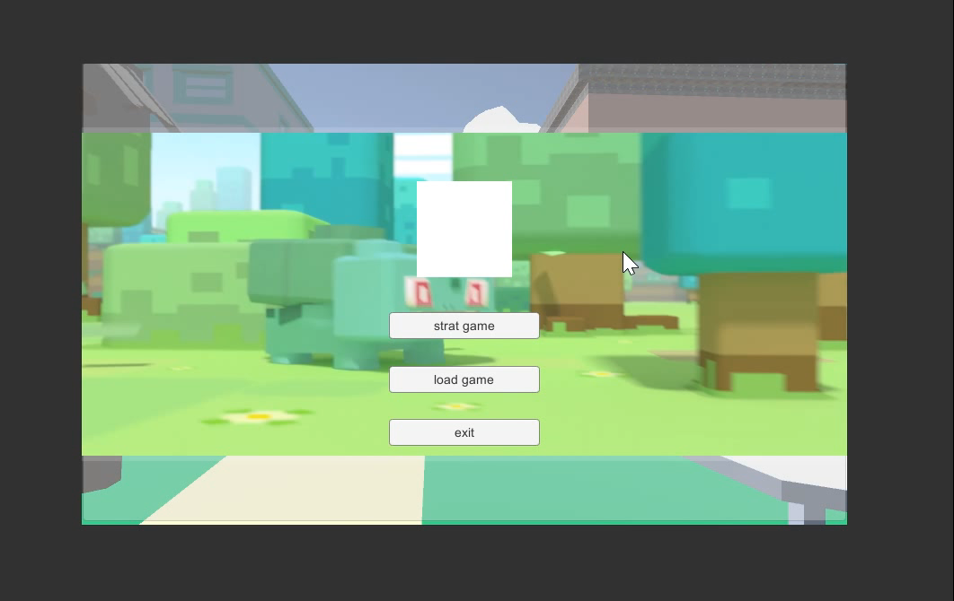
A demo for UI and scene

Slide 8
Feature description -
Rear End

Slide 9
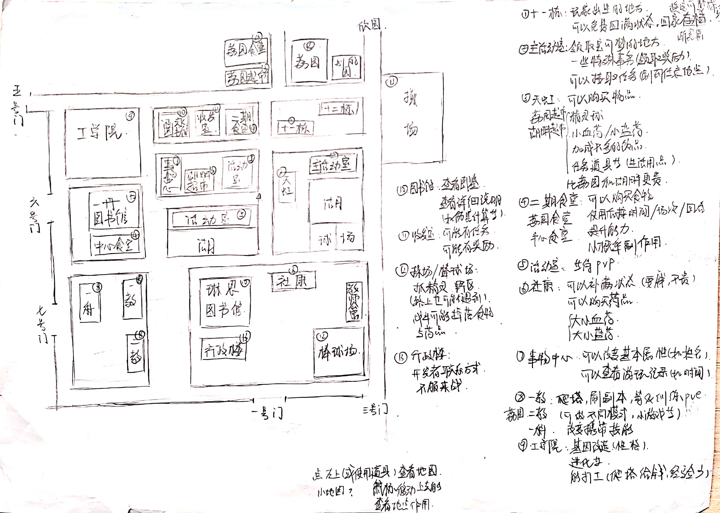
Game Design
Almost a reproduction for orthodox works of Pokemon series
Basic Function:【have done】
PvE and PvP battle of Pokemons
~Fight, Use items and Escape
~Type, Stat, Move, variable and accurate
Damage calculation
Advanced Function:
Pokemon Growth System:【have done】
~learn and change Moves
~gain experience to Level Up
~different Growth Path on every Pokemons
~alterable Natures that effect on statistic
~Status Condition and variable Items
~Evolution
Player Activity System:【plan to do】
~Mission to earn money
~Store system
~Catch Pokemon
~Pokedex
~Save and Load

Slide 10
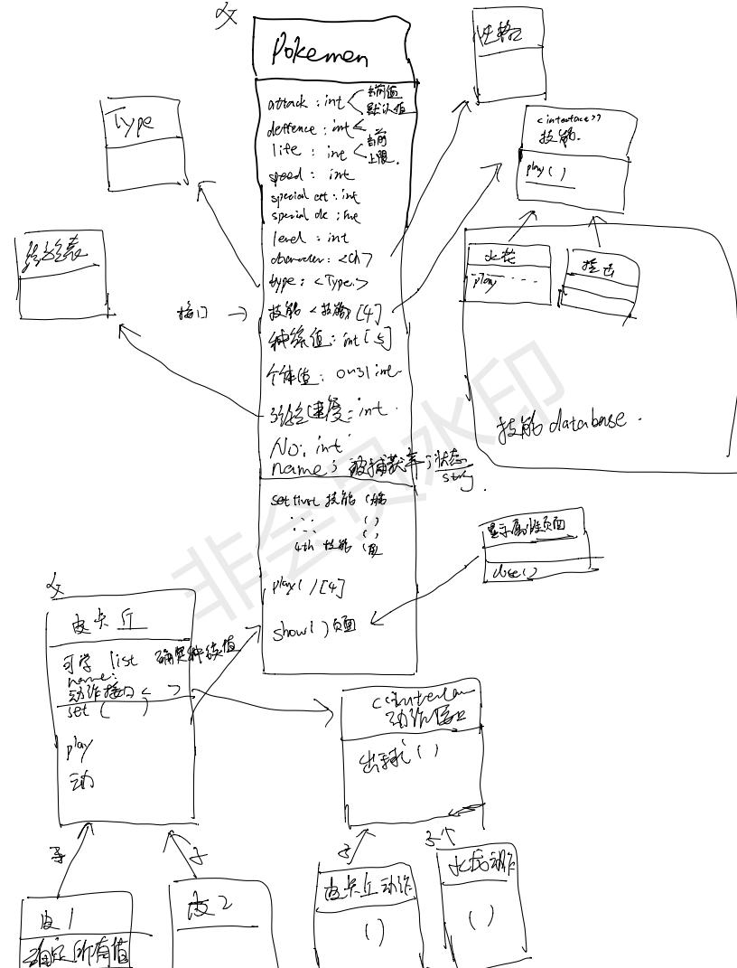
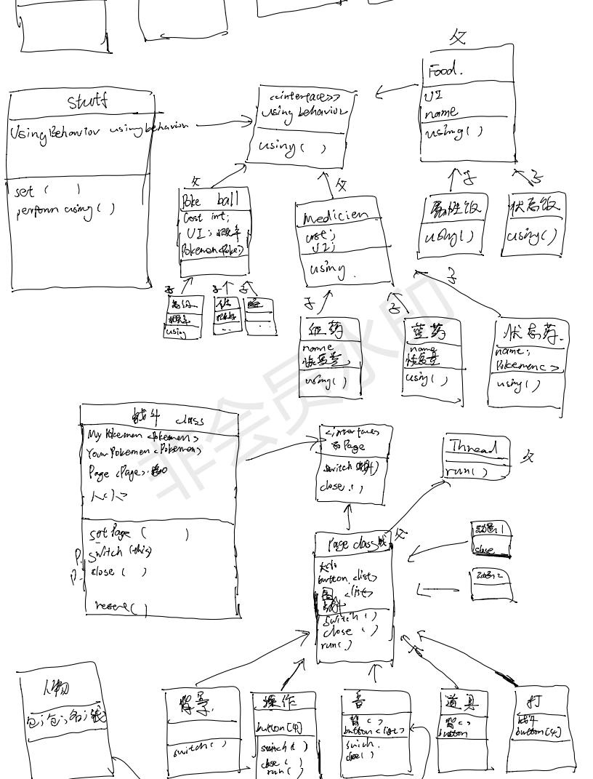
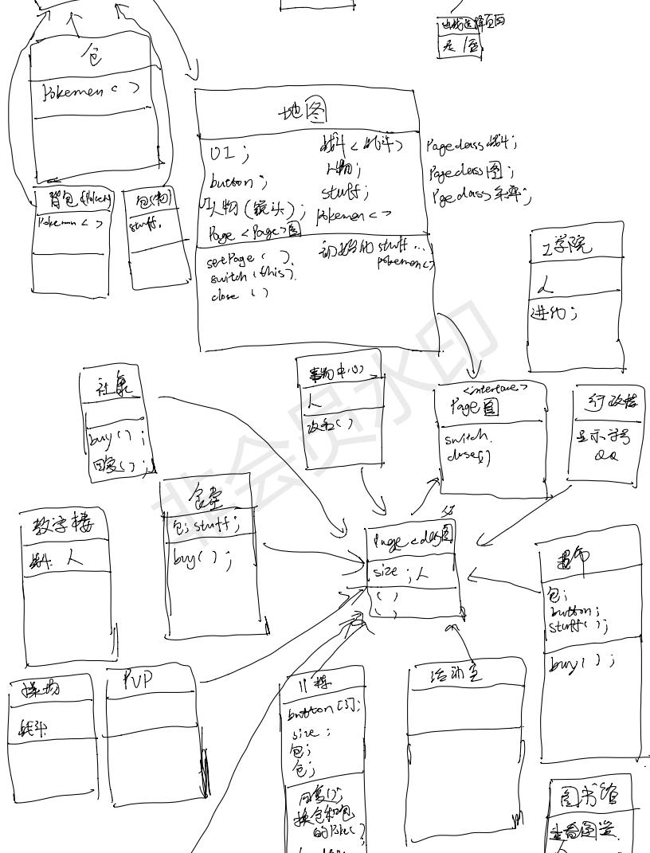
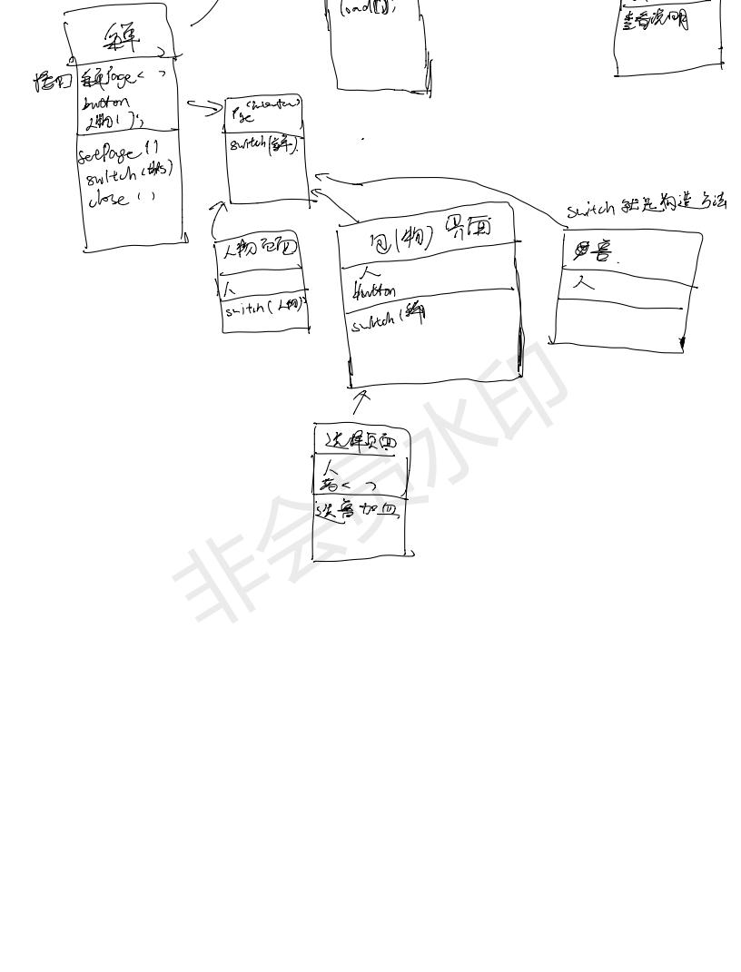
Structure Design
A hand-drawn Class Diagram of UML

Slide 11
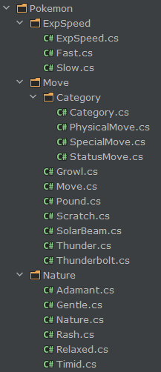
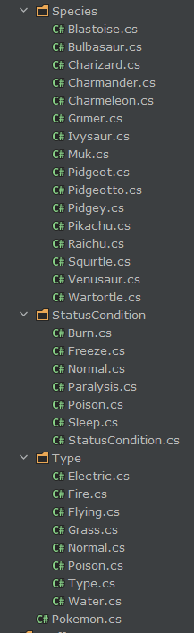
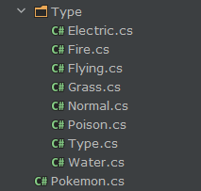
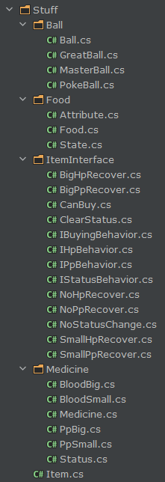
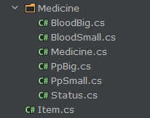
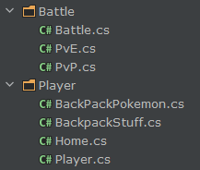
Coding
The class we have coded (super class bordered)

Slide 12
Techniques
Unity3D
Visual Studio - C#
JetBrains Rider - C#
Blender - modeling
PhotoShop

Slide 13
Timeline
9.9
~Form a team
9.10
~Determine the topic
9.14
~Determine the style
9.15
~Game design
9.28 - 10.2
~Pokemon modeling
~Scene modeling
~Structure design
10.3 - 10.7
~UI
~Coding
10.8 - 10.10
~thought the deadline was 10.15
~change the Game design
~dried off life and liver
10.11 - 10.13
~heard the deadline was NOT 10.15
~on National Day holiday
10.14
~make this PPT

Slide 14
THANK YOU
We will continue to complete the project as design

